Slide 1
Team Segfault – Engine and gearbox
Viral Soni
Tina Chehrsimin
Petter Emanuelsson
William Stridsberg

Slide 2
Minimum viable product
ENGINE SIMULATION
Acceleration
Brake
Engine ON/OFF
Gear mode
Kill switch
Speed
RPM
Engine ON/OFF
Gear mode
CAN
CAN

Slide 3
Current product overview
Inputhandler
Simulator
GUI
Keyboard input
Engine and gearbox
Show cool stuff

Slide 4

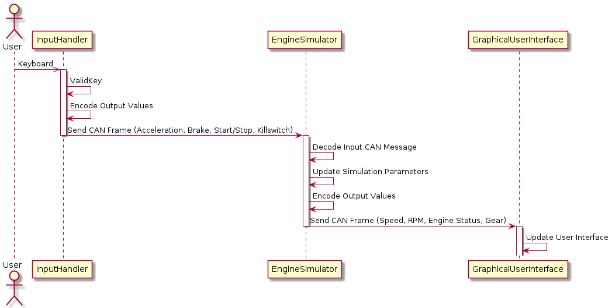
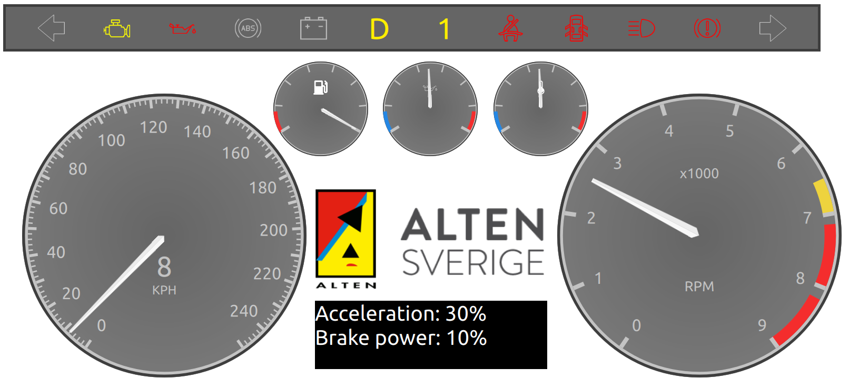


Sequence diagram

Slide 5
Unit testing
Engine – separate binary with test cases
  Start/Stop
  RPM increase/decrease
  Emergency shutdown / Kill switch
  Mock for fuel consumption

Slide 6
Backlog
Unit tests for remainder of system
Manual gearing
Fuel consumption calculation
Overheating
ABS on max brake

Slide 7
THANK YOU!

